Slide 1

Notes:
Note: before starting launch LabVIEW and the Example Finder, and do a palette search to have everything loaded and ready to go.

Slide 2
LabVIEW for FRC
Doug Norman
National Instruments
January 6, 2012
Notes:
This presentation is a basic introduction to LabVIEW, followed by what makes the FRC version different, and what is new for FRC 2011. It is not intended to teach LabVIEW.

Slide 3
Overview
Introduction to LabVIEW
FRC edition of LabVIEW
Notes:
Note that there is something for everybody – new and experienced users will benefit from this presentation.

Slide 4
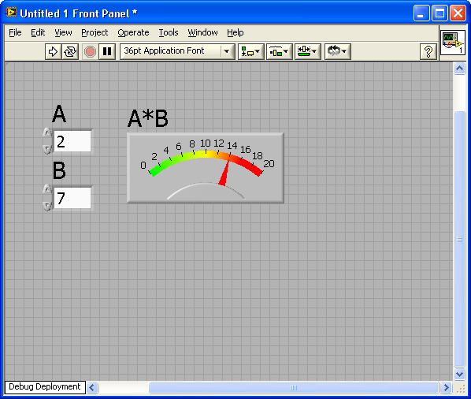
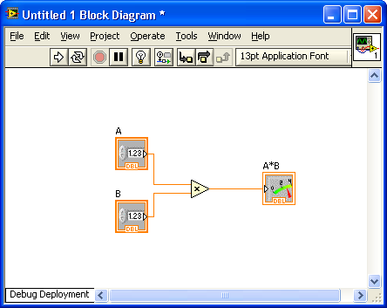
Part 1 - What is LabVIEW?
Speak G
Graphical programming language
Go with the flow
Dataflow programming
Easy writing
Easy to learn
Powerful debugging tools
Notes:
LabVIEW is a graphical programming language – you draw your program. It is easy to learn and use, while also being a powerful, full featured programming language. LabVIEW uses data flow, meaning that a node does not run until it has all the data from previous nodes at its input wires.

Slide 5
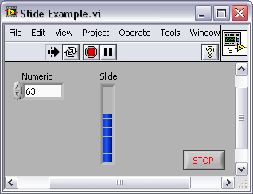
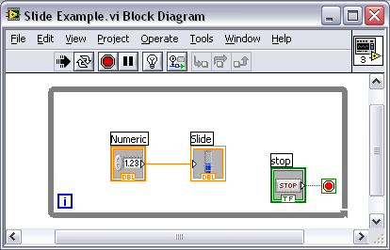
LabVIEW Programs Are Called Virtual Instruments (VIs)
Each VI has 2 Windows
Front Panel
User Interface (UI)
Controls = Inputs
Indicators = Outputs
Block Diagram
Graphical Code
Data travels on wires from controls through functions to indicators
Blocks execute by Dataflow
Notes:
LabVIEW is a graphical programming language – you draw your program. It is easy to learn and use, while also being a powerful, full featured programming language. LabVIEW uses data flow, meaning that a node does not run until it has all the data from previous nodes at its input wires.
LabVIEW programs are called virtual instruments (VIs).
Controls are inputs and indicators are outputs.
Each VI contains three main parts:
Front Panel – How the user interacts with the VI.
Block Diagram – The code that controls the program.
Icon/Connector – Means of connecting a VI to other VIs.
In LabVIEW, you build a user interface by using a set of tools and objects. The user interface is known as the front panel. You then add code using graphical representations of functions to control the front panel objects. The block diagram contains this code. In some ways, the block diagram resembles a flowchart.
Users interact with the Front Panel when the program is running. Users can control the program, change inputs, and see data updated in real time. Controls are used for inputs such as, adjusting a slide control to set an alarm value, turning a switch on or off, or to stop a program. Indicators are used as outputs. Thermometers, lights, and other indicators display output values from the program. These may include data, program states, and other information.
Every front panel control or indicator has a corresponding terminal on the block diagram. When a VI is run, values from controls flow through the block diagram, where they are used in the functions on the diagram, and the results are passed into other functions or indicators through wires.
Introduction to LabVIEW Hands-On 6 ni.com

Slide 6
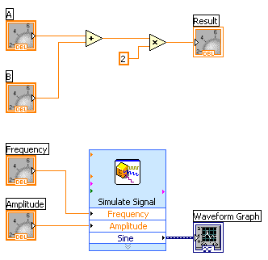
Dataflow Programming
Block diagram execution
Dependent on the flow of data
Block diagram does NOT execute left to right
Node executes when data is available to ALL input terminals
Nodes supply data to all output terminals when done
Notes:
Note – this slide is hidden
LabVIEW follows a dataflow model for running VIs. A block diagram node executes when all its inputs are available. When a node completes execution, it supplies data to its output terminals and passes the output data to the next node in the dataflow path. Visual Basic, C++, JAVA, and most other text-based programming languages follow a control flow model of program execution. In control flow, the sequential order of program elements determines the execution order of a program.
Consider the block diagram above. It adds two numbers and then multiplies by 2 from the result of the addition. In this case, the block diagram executes from left to right, not because the objects are placed in that order, but because one of the inputs of the Multiply function is not valid until the Add function has finished executing and passed the data to the Multiply function. Remember that a node executes only when data are available at all of its input terminals, and it supplies data to its output terminals only when it finishes execution. In the second piece of code, the Simulate Signal Express VI receives input from the controls and passes its result to the Graph.
You may consider the add-multiply and the simulate signal code to co-exist on the same block diagram in parallel. This means that they will both begin executing at the same time and run independent of one another. If the computer running this code had multiple processors, these two pieces of code could run independent of one another (each on its own processor) without any additional coding.
© National Instruments Corporation 14 Introduction to LabVIEW Hands-On

Slide 7
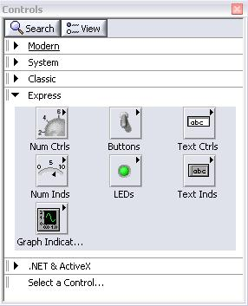
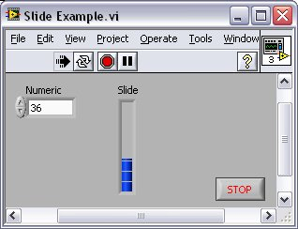
Controls Palette (Controls & Indicators)
Customize Palette View
Control:
Numeric
Indicator:
Numeric Slide
Notes:
Note – this slide is hidden
Use the Controls palette to place controls and indicators on the front panel. The Controls palette is available only on the front panel. To view the palette, select Window»Show Controls Palette. You also can display the Controls palette by right-clicking an open area on the front panel. Tack down the Controls palette by clicking the pushpin on the top left corner of the palette.
© National Instruments Corporation 7 Introduction to LabVIEW Hands-On

Slide 8
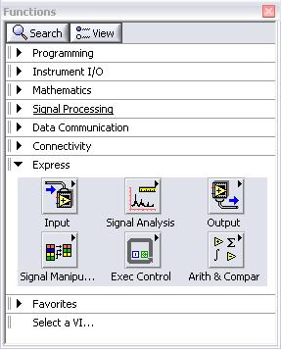
Functions (and Structures) Palette
(Place items on the
Block Diagram Window)
Structure:
While Loop
Notes:
Note – this slide is hidden
Use the Functions palette to build the block diagram. The Functions palette is available only on the block diagram. To view the palette, select Window»Show Functions Palette. You also can display the Functions palette by right-clicking an open area on the block diagram. Tack down the Functions palette by clicking the pushpin on the top left corner of the palette.
Introduction to LabVIEW Hands-On 8 ni.com

Slide 9
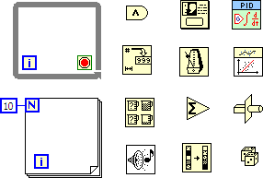
LabVIEW Nodes
While loop
For loop
Boolean logic
PID Control
Arrays
Signal processing
Mathematics
Timing
Notes:
LabVIEW contains many structures such as the While Loop, For Loop, Case, Sequence, Event, etc.
LabVIEW can perform numeric, Boolean, string, and array manipulations.
LabVIEW also has extensive libraries for mathematics, signal processing, timing, etc.

Slide 10
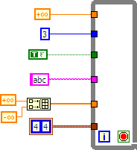
LabVIEW Types
Floating point
Integer
Boolean
String
Array – note wire thickness
Cluster
Notes:
Note wire color, style, and thickness represent the different types

Slide 11
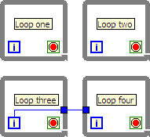
LabVIEW Tasks
Multiple tasks in parallel
Data flow still applies
Loops 1, 2, and 3 will run
Loop 4 runs after 3 stops

Slide 12
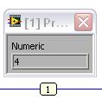
Debugging Techniques
Finding Errors
Execution Highlighting
Probes
Click on broken Run button.
Window showing error appears.
Click on Execution Highlighting button; data flow is animated using bubbles. Values are
displayed on wires.
Right-click on wire to display probe and it shows data as it flows through wire segment.
You can also select Probe tool from Tools palette and click on wire.
Notes:
When your VI is not executable, a broken arrow is displayed in the Run button in the palette.
Finding Errors: To list errors, click on the broken arrow. To locate the bad object, click on the error message.
Execution Highlighting: Animates the diagram and traces the flow of the data, allowing you to view intermediate values. Click on the light bulb on the toolbar.
Probe: Used to view values in arrays and clusters. Click on wires with the Probe tool or right-click on the wire to set probes.
Retain Wire Values: Used in conjunction with probes to view the values from the last iteration of the program.
Breakpoint: Set pauses at different locations on the diagram. Click on wires or objects with the Breakpoint tool to set breakpoints.
Introduction to LabVIEW Hands-On 15 ni.com

Slide 13
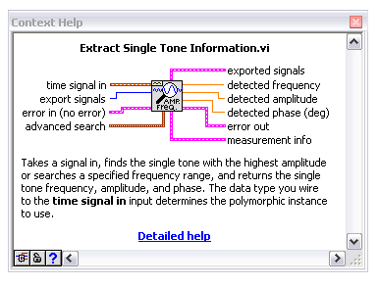

Context Help Window
Help»Show Context Help or press <Ctrl+H>
Hover cursor over object to update window
Additional Help
Right-Click on the VI icon and choose Help, or
Choose “Detailed Help.” on the context help window
Notes:
The Context Help window displays basic information about LabVIEW objects when you move the cursor over each object. Objects with context help information include VIs, functions, constants, structures, palettes, properties, methods, events, and dialog box components.
To display the Context Help window, select Help»Show Context Help, press the <Ctrl+H> keys, or press the Show Context Help Window button in the toolbar
Connections displayed in Context Help:
Required – bold Recommended – normal Optional – dimmed
Additional Help
VI, Function, & How-To Help is also available.
Help» VI, Function, & How-To Help
Right-click the VI icon and choose Help, or
Choose “Detailed Help.” on the context help window.
LabVIEW Help – reference style help
Help»Search the LabVIEW Help…
Introduction to LabVIEW Hands-On 16 ni.com

Slide 14
Part 2 - FRC Version of LabVIEW
CompactRIO with custom FPGA image
Vision and Robotics palettes
Custom Getting Started Window
Wizards to create robot and dashboard code
FRC specific examples
FRC specific tutorials
Notes:
Each topic is explained in following slides.

Slide 15
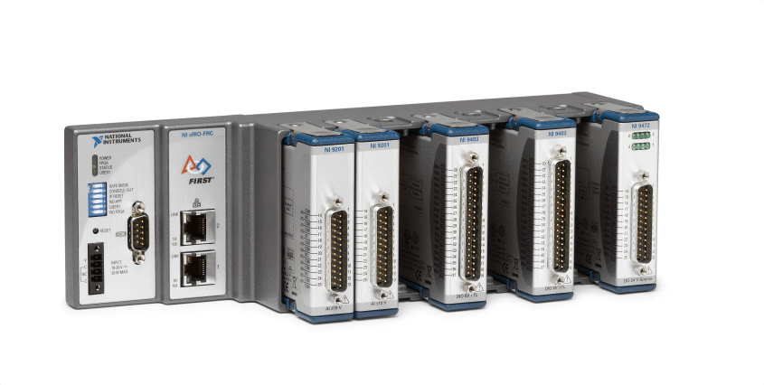
CompactRIO with Custom FPGA
(note wrong module order)
Custom FPGA image for specific I/O modules
Analog, digital, and solenoid modules
Read sensors, control motors and actuators
Notes:
For FRC, the FPGA image is customized for specific cRIO modules in specific slots. You cannot edit the FPGA image, but it is already designed for robot I/O.
cRIO modules include:
NI 9201 analog input module that can be used in slots 1 and 5 on the NI cRIO-FRC and slots 1 and 4 on the NI cRIO-FRC II. These are used for reading voltages, accelerometers, gyros, and magnetic encoders.
NI 9403 digital I/O module that can be used in slots 2 and 6 on the NI cRIO-FRC and slots 2 and 4 on the NI cRIO-FRC II. These are used for counters, digital encoders, ultrasonic sensors, I2C sensors, SPI sensors, and controlling motors and relays.
NI 9472 solenoid module that can be used in slots 3 and 7 on the NI cRIO-FRC and slots 3 and 4 on the NI cRIO-FRC II. This are used for controlling pneumatic solenoids.

Slide 16
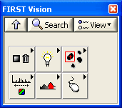
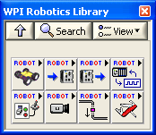
FRC Vision and Robotics Palettes
Vision – manage and analyze images
WPI Robotics – Robot Drive, Sensors, Actuators, I/O, Driver Station, Camera, Communications, Utilities. This contains most of what you will use to program your robot.
Notes:
Show these in LabVIEW. Briefly look at the WPI Robotics sub palettes. While these are FRC specific, other palettes are also useful: Structures, Array, Numeric, Boolean, String, Comparison, Timing, etc.
In LabVIEW, do a palette search with context help window open. Notice how it shows individual VIs/functions as well as sub palettes.

Slide 17
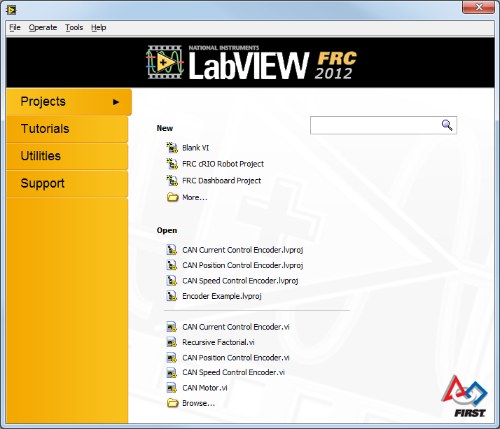
Custom Getting Started Window
Notes:
Wizards to create robot and Dashboard code (next slide)
Message to update software if needed
Find FRC Examples…
We’ll look at what’s new in the next section of this presentation

Slide 18
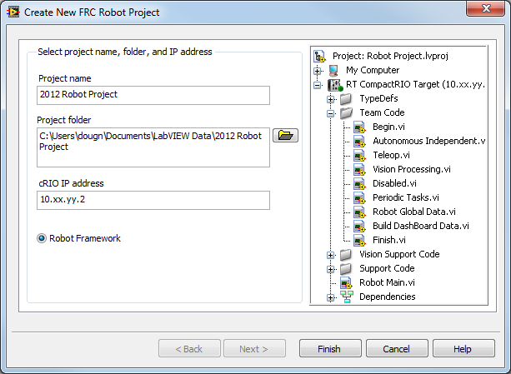
FRC Wizards for Robot and Dashboard
Notes:
Show this in LabVIEW.
Robot:
From the Getting Started Window click FRC cRIO Robot Project.
Choose project name and location, and fill in team number.
Click Finish.
Expand Team Code folder of VIs, mention Robot Main.vi. We can learn the details of these from the Getting Started Window Tutorials (future slide).
Dashboard:
From the Getting Started Window click FRC Dashboard Project.
Choose project name and location.
Click Finish.
Open Dashboard Main.vi. We can learn more about this from the Getting Started Window Tutorials (next slide).

Slide 19
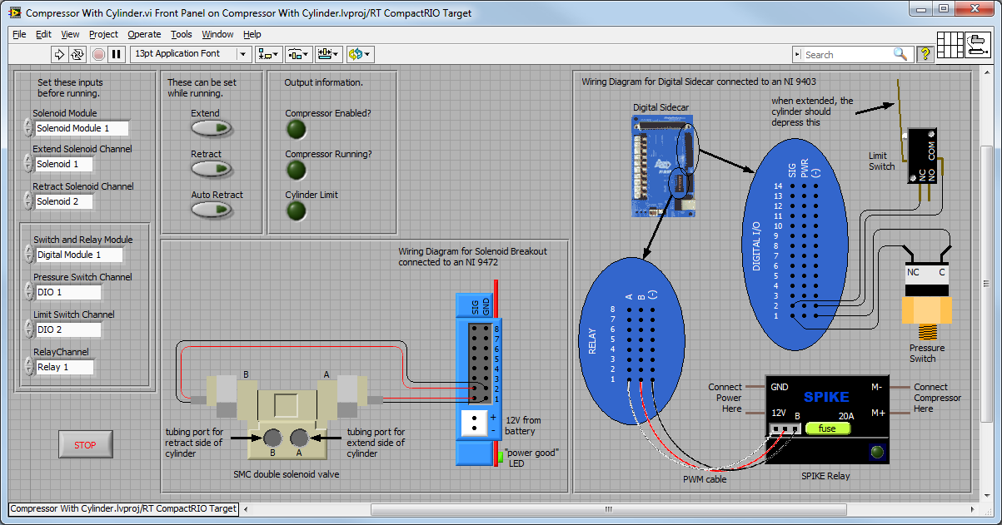
FRC Specific Examples
Notes:
There are over 50 FRC specific examples – more added every year
They tell you what to configure before running, and what can be changed while running.
They all include wiring diagrams to aid in setting up and troubleshooting your electrical system – even if you don’t program in LabVIEW!

Slide 20
Tutorials
Set up cRIO
Set up Axis Camera
Set up Robot Radio
Develop Robot Project
Editing Team Code
Custom Dashboard
Integrating Examples
Integrating Vision
CAN Jaguar
Notes:
Many existing tutorials.
Two new tutorials:
Integrating Vision into Robot Code
CAN Jaguar Fundamentals

Slide 21
Conclusion
LabVIEW is easy to learn yet very powerful
Many custom VIs, examples and tools for FRC
New and improved features for FRC 2012
To learn more, visit ni.com/first
Questions?

